Slide 1
CS101 Project 2015
AIR HOCKEY
Jainam Shah 14D070014
Tuhinangshu Choudhury 140070024 Shubham Kumar 140040084
Somesh Singh Sikarwar 140070074

Slide 2
An Introduction to the Game
Air hockey is a game for two competing players trying to score points in the opposing player's goal using a table having a special low-friction playing surface.
Air hockey table consists of large smooth playing surface, a surrounding rail to prevent the puck and mallets from leaving the table, and slots in the rail at either end of the table that serve as goals.

Slide 3
Abbreviation used in the game
Mallet:. In our game the mallet is a circular disc like structure that user controls using the mouse while the computer controls using AI.
Puck:- It is a circular disc that user and computer hits using the mallet to score goals.
Goal:-Situation when a player wins a points by hiting the puck inside a definite box of the opponent.

Slide 4
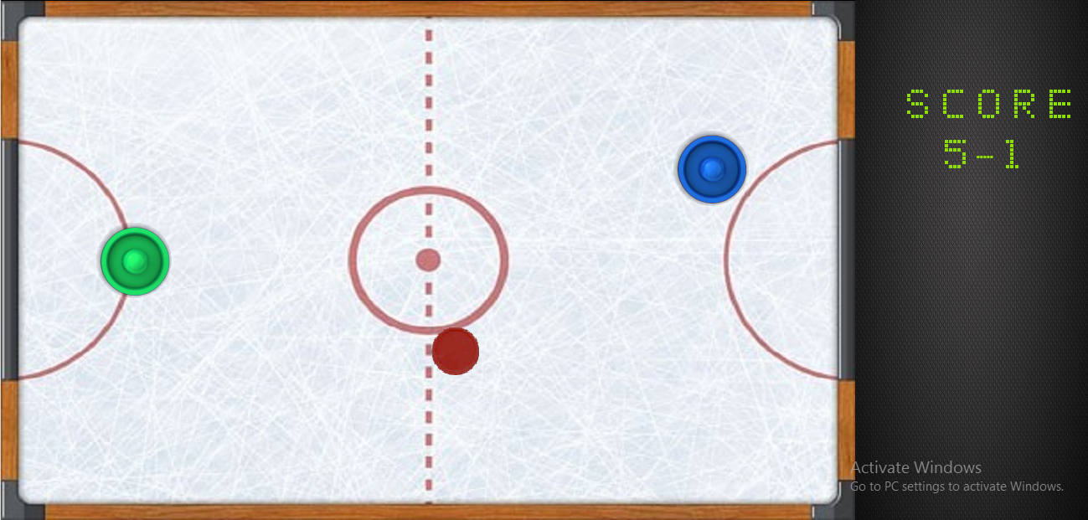
SCREENSHOTS

Slide 5
Problem Statement
The aim of the project is to build a software version of the game with fluid and visually appealing graphics .
The game will be having artificial intelligence to play as opponent and collision function along with vector and scoring functions.

Slide 6
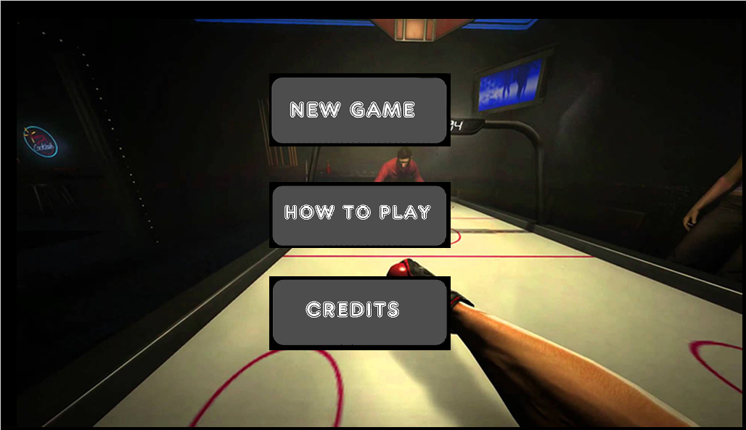
SCREENSHOTS

Slide 7
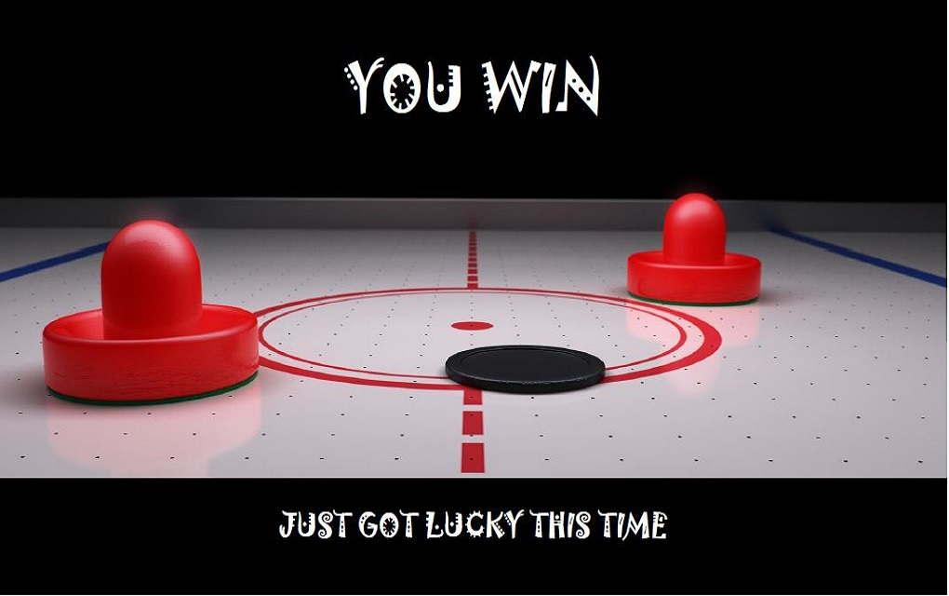
SCREENSHOTS

Slide 8
Challenges
The first and foremost problem we faced was writing proper collision equation .
Sometimes the two circles intrude into each other due to high velocities .
At particularly high velocities the puck crosses over the mallet without bouncing off.
The solution to this ,is overcome by using proper collision dynamics and the concept of interpolation of frames.

Slide 9
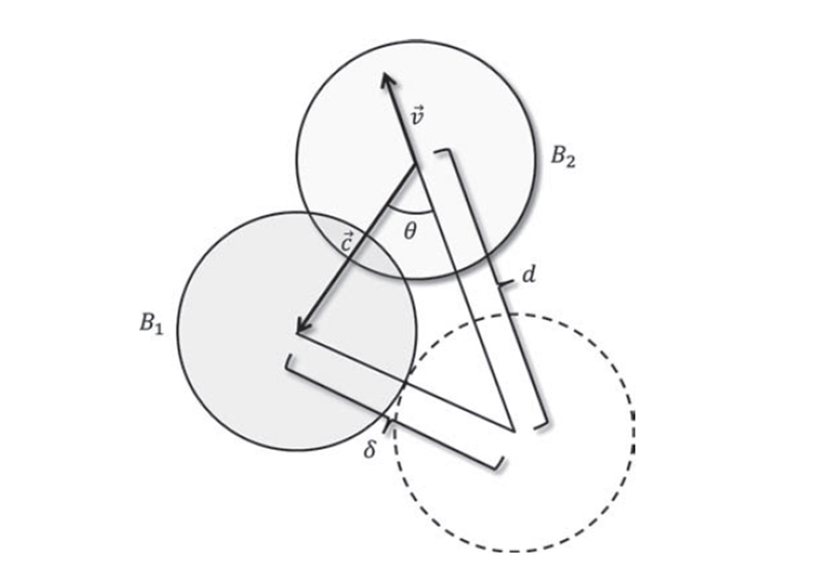
Challenges

Slide 10
Challenges
Initially the game was lagging due to unarranged code
It was difficult to arrange in such a way so as to make the game time efficient
Thus we came up to following method

Slide 11
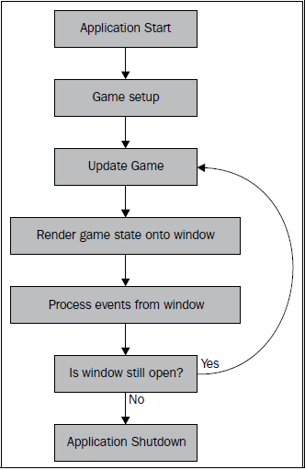
Challenges

Slide 12
Challenges
The artificial intelligence (AI) function itself was a challenge. Like:
Making the AI algorithm difficult to beat and equally defeatable
Integrating the AI with main program and interface
To confine the computer mallet within the boundary condition by taking care of all the collision
To find the intersection point by considering all the collision between the wall and puck

Slide 13
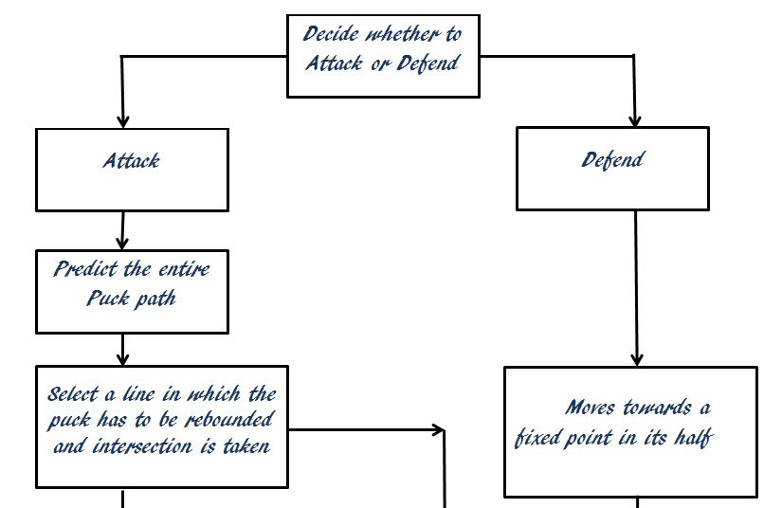
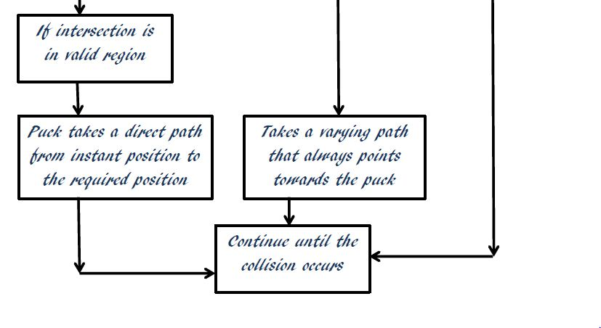

Slide 14
Innovations
The interface was a made a bit more helpful and user-friendly
The win or lose result screens add fun to the game
The AI algorithm was also a bit changed to add randomness and make it beatable

Slide 15
Future Work
Concept of air hockey can be developed to convert it into multiplayer football game.
Inclusion of tournament modes with increasingly level of difficulty.
Multiplayer version of the game using LAN connections.
May be developed to play online matches.
Using of boosters during the game such as powerbooster to give an extremely powerful shots.
User controlling of colours of mallets and puck.

Slide 16
Thank You!

